Slide 1
Quality Attributes
Software Design & Architecture

Slide 2
Introduction
Functionality is the basic statement of the system’s capability, services and behaviour
Various quality attributes need to be accommodated in the architecture
Functionality and quality attributes are orthogonal
As an architect, our choices will determine the desired level of quality for a particular function
How to separate concerns?

Slide 3
Architecture & Quality Attributes
Achieving quality has to be considered throughout the design, implementation and deployment
Get the big picture (architecture) and details (implementation) correct
  Qualities can be designed in and evaluated at architectural level
  Architecture on its own can not achieve quality
  Therefore, attention has to be paid on detail to achieve quality

Slide 4
Architecture & Quality Attributes …
Usability
  Non-architectural decisions based on making the user interface clear and easy to use
    Provide radio button or check box? Screen layout? typeface?
  Architectural decisions may include
    The ability to cancel an operation, undo operations, or re-use data previously entered
Modifiability can be determined by how functionality is divided by coding techniques within a module

Slide 5
Architecture & Quality Attributes …
Performance is dependent on
  the frequency of inter-component communication
  What functionality has been allocated to each component
  Allocation of shared resources
  Choice of algorithms
  How these algos are coded
Conflicting quality attributes
  Portability and performance
    Isolate system dependencies, introduce wrappers/converters
    More data transformations/message passing, lesser the performance

Slide 6
Classes of Quality attributes
Qualities of the system
  availability, modifiability, performance, security, testability, and usability
Business qualities such as time to market that are affected by the architecture
Qualities such as conceptual integrity that are about the architecture itself

Slide 7
System Quality Attributes
A well established domain
3 main problems from an architect’s view point
  The definitions provided for an attribute are not operational
  Overlapping attribute concerns
  Separate vocabulary for each quality attribute
first two problems can be solved by using quality attribute scenarios
Solution to the 3rd problem is a brief description of the each attribute in terms of its underlying concerns

Slide 8
Quality Attribute Scenarios
It is a quality-attribute-specific requirement
It consists of six parts
  Source of stimulus. This is some entity (a human, a computer system, or any other actuator) that generated the stimulus.
  Stimulus. The stimulus is a condition that needs to be considered when it arrives at a system.
  Environment. The stimulus occurs within certain conditions.

Slide 9
Quality Attribute Scenarios
  Artifact. Some artifact is stimulated. This may be the whole system or some pieces of it.
  Response. The response is the activity undertaken after the arrival of the stimulus.
  Response measure. When the response occurs, it should be measurable in some fashion so that the requirement can be tested.
General scenarios – system independent
Concrete scenarios – specific to a particular system

Slide 10
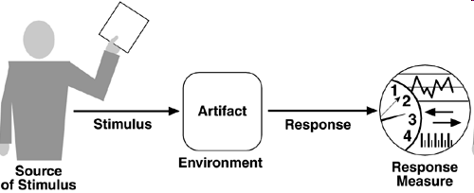
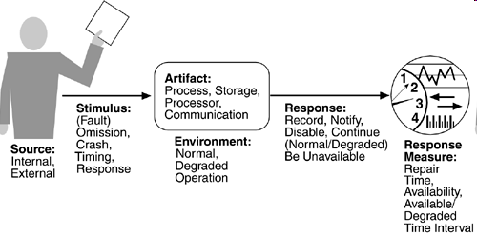
Figure: Quality attribute parts
Figure: Availability general scenario

Slide 11
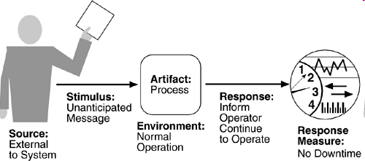
Availability Scenario – General to concrete
An unanticipated external message is received by a process during normal operation. The process informs the operator of the receipt of the message and continues to operate with no downtime.

Slide 12
Availability
Availability is concerned with system failure and its associated consequences
A system failure occurs when the system no longer delivers a service consistent with its specification
Our concerns about failure are:
  how system failure is detected
  how frequently system failure may occur
  what happens when a failure occurs
  how long a system is allowed to be out of operation
  how failures can be prevented etc.
Difference between a fault and a failure ….

Slide 13
Availability …
A fault may become a failure if not corrected or masked
A failure is observable by the system's user and a fault is not
When a fault does become observable, it becomes a failure
The availability of a system is the probability that it will be operational when it is needed. This is typically defined as

Slide 14
Availability General Scenario
Source of stimulus
  differentiate between internal and external indications of faults or failure
Stimulus
  Omission. A component fails to respond to an input.
  Crash. The component repeatedly suffers omission faults.
  Timing. A component responds but the response is early or late.
  Response. A component responds with an incorrect value.
Back to scenario

Slide 15
Availability General Scenario …
Artifact
  This specifies the resource that is required to be highly available, such as a processor, communication channel, process, or storage.
Environment
  The state of the system when the fault or failure occurs
Response
  possible reactions to a system failure
  i.e., logging the failure, notifying selected users or other systems, switching to a degraded mode with either less capacity or less function etc.
Response measure
  can specify an availability percentage, or it can specify a time to repair, times during which the system must be available etc.
Back to scenario

Slide 16
Portion of Scenario | Possible Values
Source | Internal to the system; external to the system
Stimulus | Fault: omission, crash, timing, response
Artifact | System's processors, communication channels, persistent storage, processes
Environment | Normal operation; degraded mode (i.e., fewer features, a fall back solution)
Response | System should detect event and do one or more of the following: Record it notify appropriate parties, including the user and other systems disable sources of events that cause fault or failure according to defined rules be unavailable for a pre-specified interval, where interval depends on criticality of system continue to operate in normal or degraded mode

Slide 17
Modifiability
Modifiability is about the cost of change
  What can change (the artifact)?
    A change can occur to any aspect of a system,
      the functions that the system computes
      the platform the system exists on (the hardware, operating system, middleware, etc.)
      the environment within which the system operates (the systems with which it must interoperate, the protocols it uses to communicate with the rest of the world, etc.) etc.

Slide 18
Modifiability … 2
When is the change made and who makes it (the environment)?
  Traditionally, a change is made to source code – developer
  Changes can be made to
    the implementation (by modifying the source code)
    during compile (using compile-time switches)
    during build (by choice of libraries)
    during configuration setup (by a range of techniques, including parameter setting)
    during execution (by parameter setting).
    A change can also be made by a developer, an end user, or a system administrator.

Slide 19
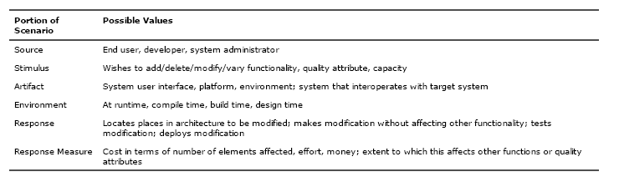
Modifiability .. 3

Slide 20
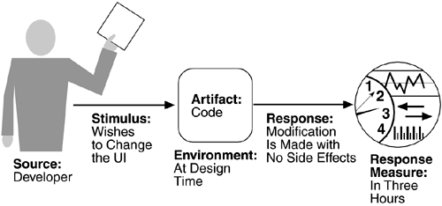
Sample Modifiability Scenario
A developer wishes to change the user interface to make a screen's background color blue. This change will be made to the code at design time. It will take less than three hours to make and test the change and no side effect changes will occur in the behavior.

Slide 21
Performance General Scenario
Table Performance General Scenario Generation
Portion of Scenario | Possible Values
Source | One of a number of independent sources, possibly from within system
Stimulus | Periodic events arrive; sporadic events arrive; stochastic events arrive
Artifact | System
Environment | Normal mode; overload mode
Response | Processes stimuli; changes level of service
Response Measure | Latency, deadline, throughput, jitter, miss rate, data loss

Slide 22
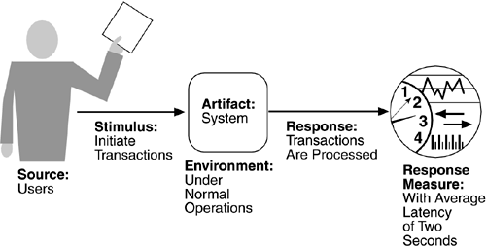
Sample Performance Scenario
"Users initiate 1,000 transactions per minute stochastically under normal operations, and these transactions are processed with an average latency of two seconds."

Slide 23
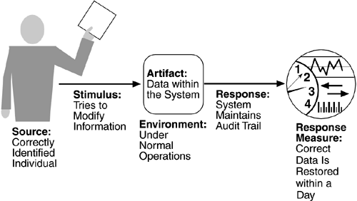
Sample Security Scenario
A correctly identified individual tries to modify system data from an external site; system maintains an audit trail and the correct data is restored within one day.

Slide 24
Testability General Scenario
Table 4.5. Testability General Scenario Generation
Portion of Scenario | Possible Values
Source | Unit developer Increment integrator System verifier Client acceptance tester System user
Stimulus | Analysis, architecture, design, class, subsystem integration completed; system delivered
Artifact | Piece of design, piece of code, complete application
Environment | At design time, at development time, at compile time, at deployment time
Response | Provides access to state values; provides computed values; prepares test environment
Response Measure | Percent executable statements executed Probability of failure if fault exists Time to perform tests Length of longest dependency chain in a test Length of time to prepare test environment
USABILITY

Slide 25
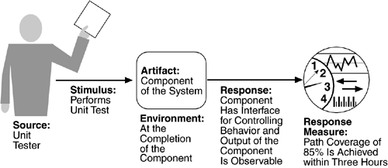
Sample Testability Scenario
A unit tester performs a unit test on a completed system component that provides an interface for controlling its behaviour and observing its output; 85% path coverage is achieved within three hours.

Slide 26
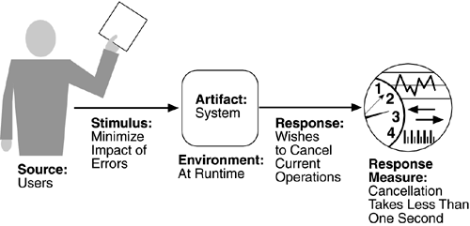
Sample Usability Scenario
A user, wanting to minimize the impact of an error, wishes to cancel a system operation at runtime; cancellation takes place in less than one second.

Slide 27
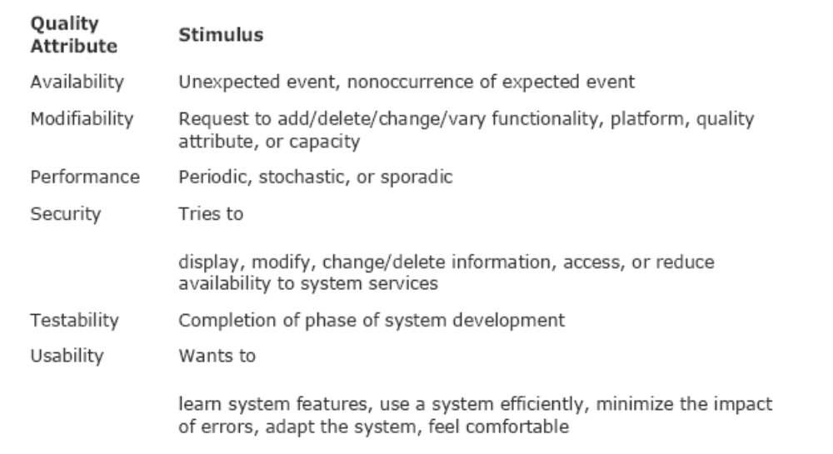
Quality Attribute Stimuli

Slide 28
Business Qualities
Time to market
Cost and benefit
Projected lifetime of the system
Targeted market
Rollout schedule
Integration with legacy systems

Slide 29
Architecture Qualities
Conceptual integrity
  the underlying theme or vision that unifies the design of the system at all levels
Correctness and completeness
  allows for all of the system's requirements and runtime resource constraints to be met.
Buildability
  allows the system to be completed by the available team in a timely manner
  It also enable the system to be open to certain changes as development progresses

Slide 30
References and Reading Material
Chapter 4, “Understanding Quality Attributes” from Software Architecture in Practice by Len Bass.

